Slide 1
Practical Guide to Celery in Production
Mahesh Mahadevan
(Principal Software Engineer at Avoma)
Notes:
Speaker introduction and small background about Avoma and its product ( 2 mins )

Slide 2
Overview
Django + Celery
How we run Celery
Deployment of Celery
Monitoring Celery
Stories
Current Challenges
Notes:
Run through more of introduction on Django and Celery , Understand the Audience to guage the depth to go into, Set the expectations on the level of technical understanding required to make sense of the talk ( 1 min )

Slide 3
Django + Celery
Django - Python rapid development web framework
Top companies using Django - Instagram , Youtube , Spotify etc
Celery - Distributed Task queue for Django Apps
Offload work that can run independently eg: Email Events , Video/Image/Text Processing , Generate Reports
Works on AMQP
Supports Redis , RabbitMQ , SQS
Notes:
Very high level explanation of both Django and Celery frameworks with examples where they are used (1-2 mins ) - Use this slide to set the Aim of this talk

Slide 4
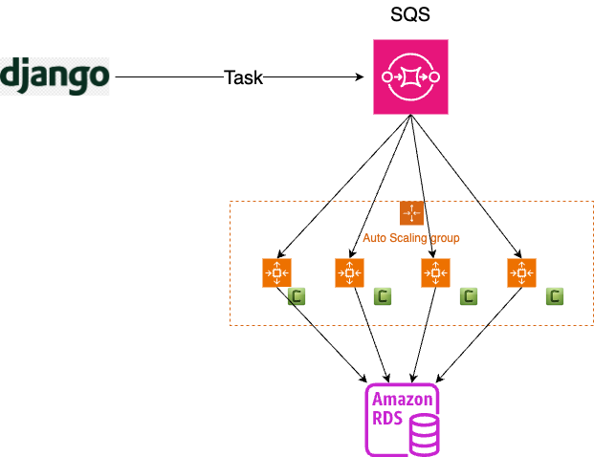
How we run Celery - Simplified View
SQS as Broker
AWS EC2 Spot Instances for workers
Auto Scaling Group for scaling
Time based and Predictive Scaling
Notes:
Details on how Avoma runs celery in production, little more descriptive picture on the lay of the land and what is needed to run on celery on production scale ( 5 mins )

Slide 5
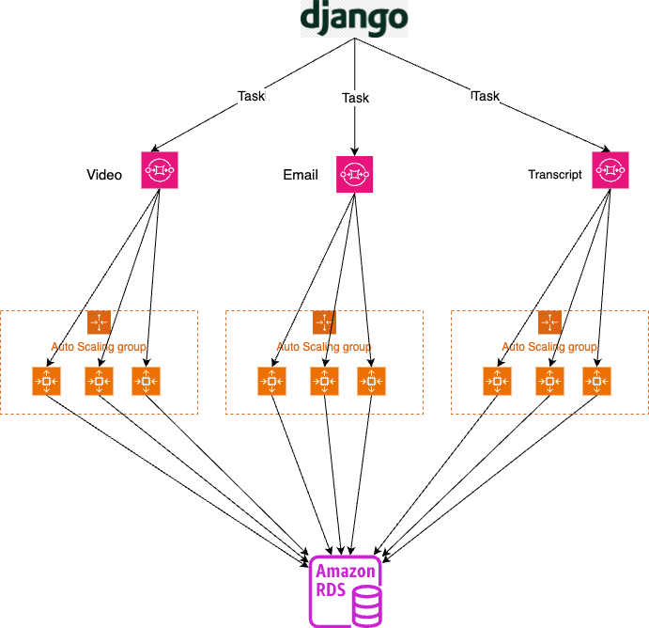
How we run Celery - Complex View
Mapping queues to different Auto Scaling Groups
ASG manage different workloads and their speed
Queues mapping to ASG done via Tags
Bespoke concurrency for every worker

Slide 6
Scaling Spot Instances
Scaling In/Out
Addition of workers based on time ex: Increase during US time zone
Addition of workers based on queue depth ex: Increase if there are too many tasks in queue
Addition of workers based on predictive scaling
Scaling In - Spot Cycle out vs Managed Scaling
Graceful Celery termination command , does not accept new task completes task at hand
Cron script to check every few seconds if spot termination request has come for worker
Event Bridge and Lambda for checking ASG scale in events

Slide 7
Stats
UNIQUE CELERY TASKS > 150
QUEUES > 50
AUTO SCALING GROUPS > 50
NUMBER OF MESSAGES DURING PEAK > 20k
TOTAL MESSAGES ON QUEUES > 10k to ~1 Mil
TOTAL NUMBER OF WORKERS > 100 - 300
Notes:
Simple numbers on number of celery messages that go over in our production env during a peak day ( 1 min )

Slide 8
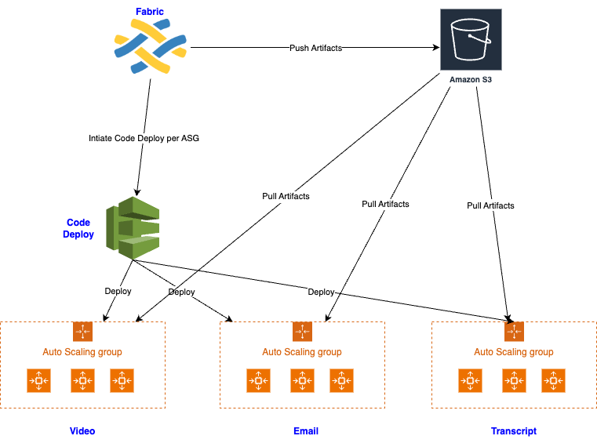
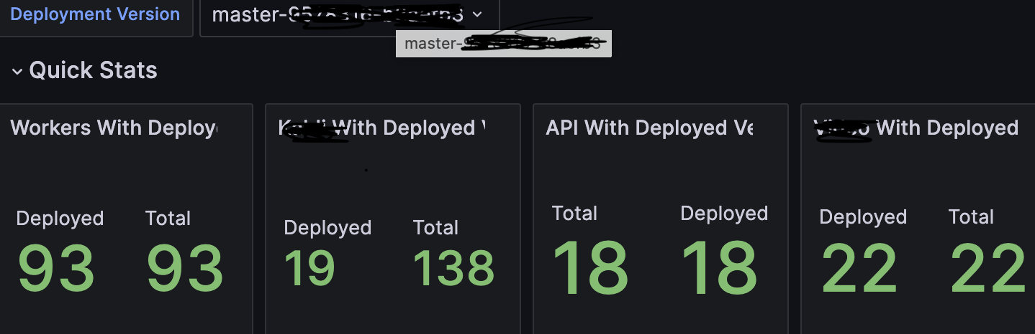
Deployment of Celery
Fabric deployment
Bundles created and pushed to s3 and deployed via remote command
AWS Code Deploy to parallelize deployment across various worker groups
Commit SHA for each deployment is added as a Tag to worker post deployment
Deployment status is synced and shown on Grafana dashboard
Notes:
How we automated and sped up the deployment of multiple workers using AWS code deploy ( 2 min )

Slide 9
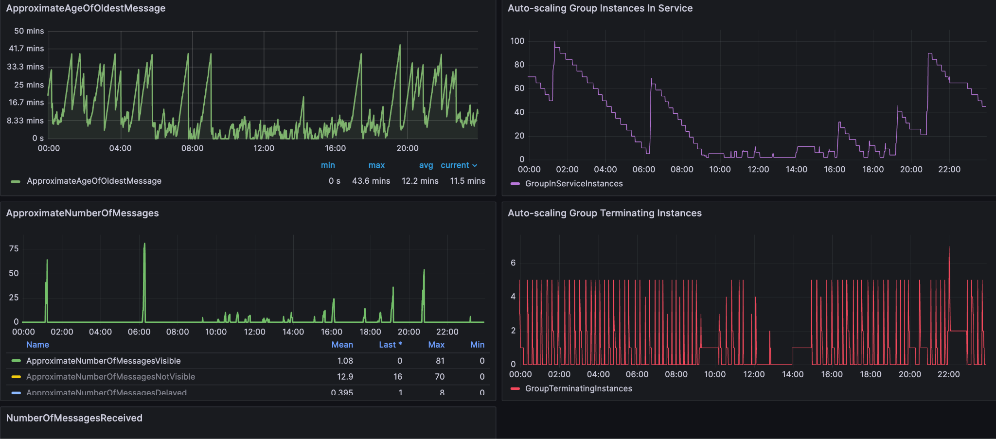
Monitoring Celery
Grafana Dashboards
SQS metrics
ASG metrics
Task processing time
Alerts on Queue depth
Alerts on Age of Oldest Message
Notes:
A Small primer on the monitoring tools we used to monitor celery ( 2 mins)

Slide 10
Production Stories
Scaling
Predictive and Time based scaling
Deployment time
Parallel deployment using Code Deploy
Graceful Shutdown for Spot Instances
Event bridge and lambda
Long running task handling
Reserve one task at a time - set tasks_ack_late =True
Separate queues based on time taken for task
Visibility Timeout
Finding the sweet spot
Notes:
Speak about actual production challenges ( 7 mins )

Slide 11
Current Challenges
Incomplete tasks cycled spot workers or unhandled exceptions
Prefetch Task Handling
Profiling Celery Tasks - using sentry or other equivalent tool
Scaling workers using docker containers
Monitoring Celery using Celery Prometheus or Flower or Build our Own :)
Notes:
Future challenges that are being worked upon ( 3 mins ) - End Note and talk about how you addressed the Aim talked about initially

Slide 12
Questions ?
Notes:
5 mins for Q & A

Slide 13
Appendix: Memory Issue
OOM Issues
Too Many Open files Issue
Profiling Celery tasks
Cprofile
Memory Profiler
Solution - Explicit Garbage Collection call
Good article to read

